Slide 1
SS ZG 526: Distributed Computing
Second Semester 2014-2015
Lect 8: Chapter 5
Chittaranjan Hota, PhD
Dept. of Computer Sc. & Information Systems
hota@hyderabad.bits-pilani.ac.in

Slide 2
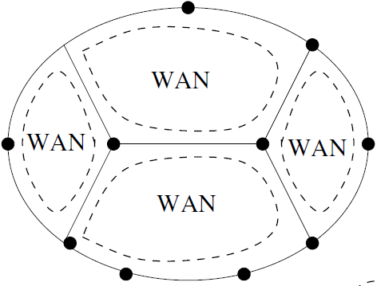
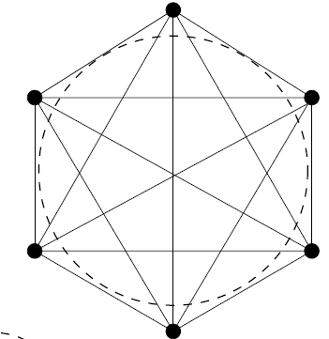
Chapter 5: Terminology and Basic Algorithms
Topology Abstraction and Overlays:
Physical topology
Nodes: network nodes, routers, all end hosts (whether participating or not)
Edges: all LAN, WAN links, direct edges between end hosts
Logical topology (application context)
Nodes: end hosts where application executes
Edges: logical channels among these nodes
SS ZG526, Distributed Computing

Slide 3
Classifications and Basic Concepts
Application execution vs. control algorithm execution
  Control algorithm
    for monitoring and auxiliary functions, e.g., creating a ST, reaching
    consensus, global state detection, checkpointing etc.
    does not interfere its send, receive, internal events with application execution
Centralized and distributed algorithms
  Centralized: asymmetric roles; client-server configuration; processing and bandwidth bottleneck; single point of failure
  Distributed: more balanced roles of nodes, difficult to design perfectly distributed algorithms (e.g., snapshot algorithms)
Symmetric and asymmetric algorithms
  In symmetric, all processors execute the same logical functions but in asymmetric each processor executes different functions.
SS ZG526, Distributed Computing

Slide 4
Continued…
Anonymous algorithm: process ids or processor ids are not used to make any run-time execution decisions
  Hard to design, or impossible, e.g., anonymous leader election is impossible
Uniform algorithm (an algo that does not use “n” the no. of processes in the system, eg. uniform algo for leader election.
Adaptive algorithm
Deterministic vs. nondeterministic executions
  Nondeterministic receive: can receive a message from any source but in deterministic receive: source is specified
Synchronous vs. asynchronous systems
  Synchronous: upper bound on message delay, known bounded drift rate of clock, and known upper bound for process to execute a logical step
  Asynchronous: above criteria are not satisfied
Process failures
  Fail-stop, Crash, Receive omission, Send omission, General omission, Byzantine (or malicious) failure with authentication, Byzantine (or malicious) failure.
SS ZG526, Distributed Computing

Slide 5
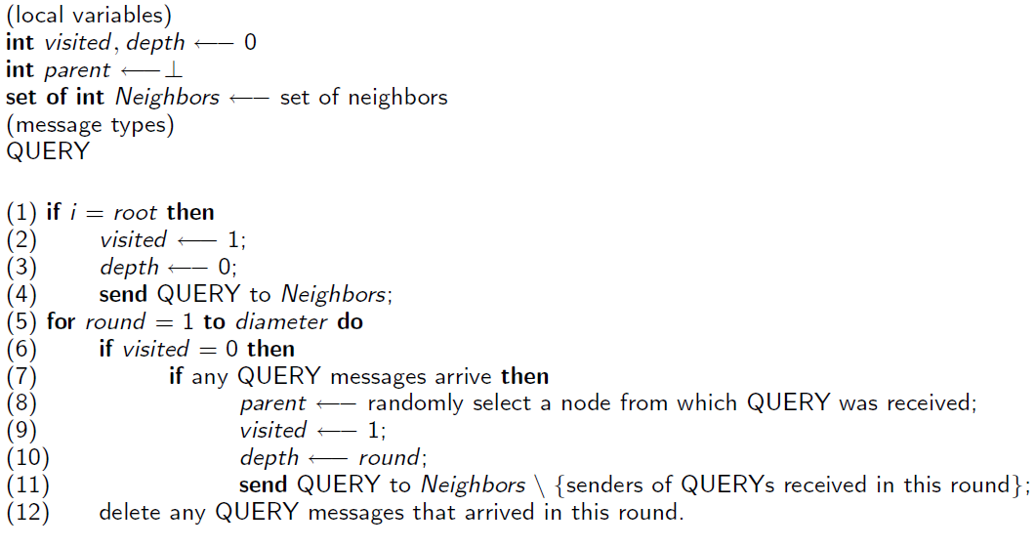
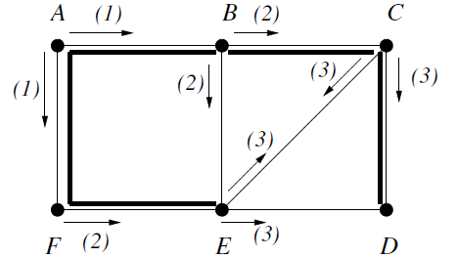
Simple Graph Algorithms: Synchronous Single-initiator spanning tree using flooding (Info distribution and collection tasks)
analogous to breadth-first search
SS ZG526, Distributed Computing

Slide 6
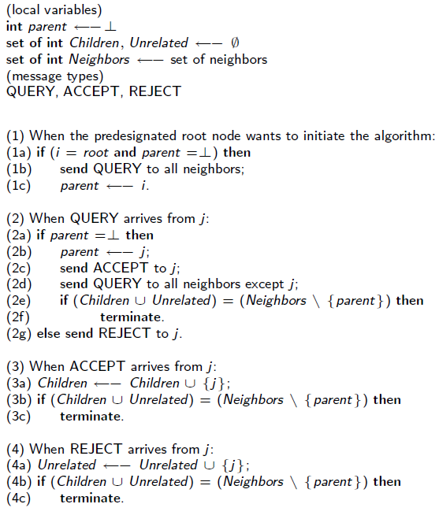
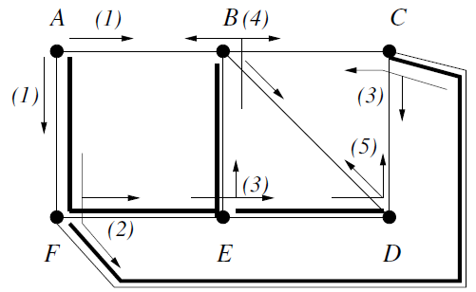
Asynchronous Single-initiator spanning tree using flooding
SS ZG526, Distributed Computing

Slide 7
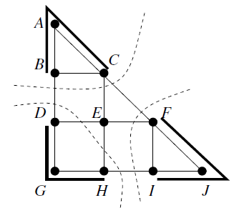
Asynchronous Spanning Tree: Concurrent Initiators
Option 1: Merge partial STs. Difficult based on local knowledge, can lead to cycles
Option 2: Allow one ST computation instance to proceed; suppress others.
SS ZG526, Distributed Computing

Slide 8
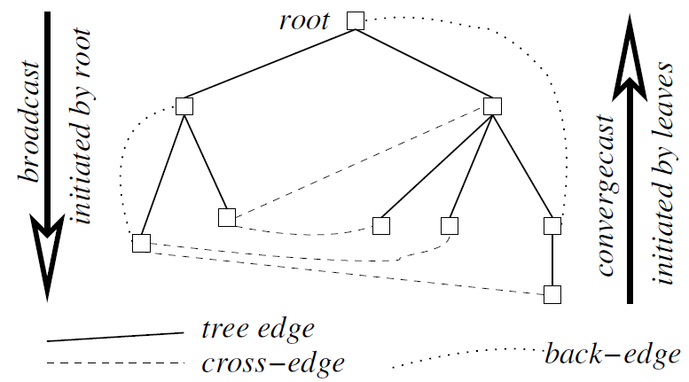
Broadcast and Convergecast on a Tree
BC1: Root sends info to be broadcast to all its children. Terminate.
BC2: When a (nonroot) node receives info from its parent, it copies it and forwards it to its children. Terminate.
CVC1: Leaf node sends its report to its parent. Terminate.
CVC2: At a non-leaf node that is not the root: When a report is received from all the child nodes, the collective report is sent to the parent. Terminate.
CVC3: At root: When a report is received from all the child nodes, the global function is evaluated using the reports. Terminate.
SS ZG526, Distributed Computing

Slide 9
Synchronizers
Mostly, it is difficult to design algorithms for Asynchronous systems than that for synchronous systems.
Definition
Class of transformation algorithms that allow a synchronous program (designed for a synchronous system) to run on asynchronous systems.
Assumption: failure-free system
Process safety
  Process i is safe in round r if all messages sent by i have been received.
  signal to each process when it is safe to go to next round, i.e., when all msg. to be received have arrived.
SS ZG526, Distributed Computing

Slide 10
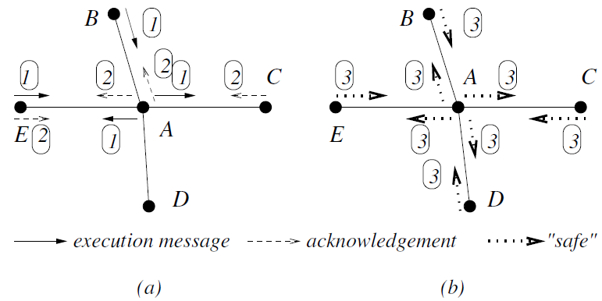
α Synchronizer
Pi in round r moves to r + 1 if all neighbors are safe for round r .
When neighbor Pj receives ack for each message it sent, it informs Pi (and its other neighbors) that it is safe.
SS ZG526, Distributed Computing

Slide 11
β Synchronizer
Initialization: rooted spanning tree
Operation:
  Safe leaf nodes initiate convergecast (CvgC)
  intermediate nodes propagate CvgC when their subtree is safe.
  When root becomes safe and receives CvgC from all children, initiates tree broadcast to inform all to move to next round.
SS ZG526, Distributed Computing

Slide 12

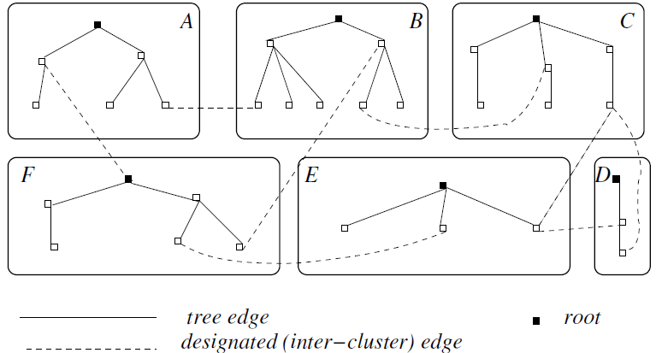
Synchronizer: Clusters
Set of clusters; each cluster has a spanning tree
Intra-cluster: β synchronizer over tree edges
Inter-cluster: α synchronizer over designated inter-cluster edges. (For 2 neighboring clusters, 1 inter-cluster edge is designated.)
SS ZG526, Distributed Computing

Slide 13


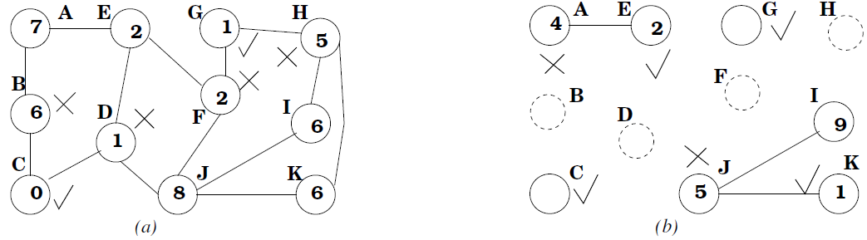

Maximal Independent Set
For a graph (N, L), an independent set of nodes N’, where N’ N, is such that for each i and j in N’, (i , j) L.
Application: Wireless broadcast where it is required that transmitters must not broadcast on the same frequency within range of each other.
Luby's Randomized Algorithm
Third round: I is winner.
SS ZG526, Distributed Computing

